Slide 1
Wikidata.lib
BP2013N2
InfoLunch 05.02.2014

Slide 2
Wikidata.lib
Wikidata
Property Suggestions
Value Suggestions
Edit Item Page
Evaluation
Hackathon
BP N2

Slide 3




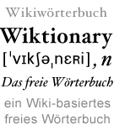
Wikidata

Slide 4
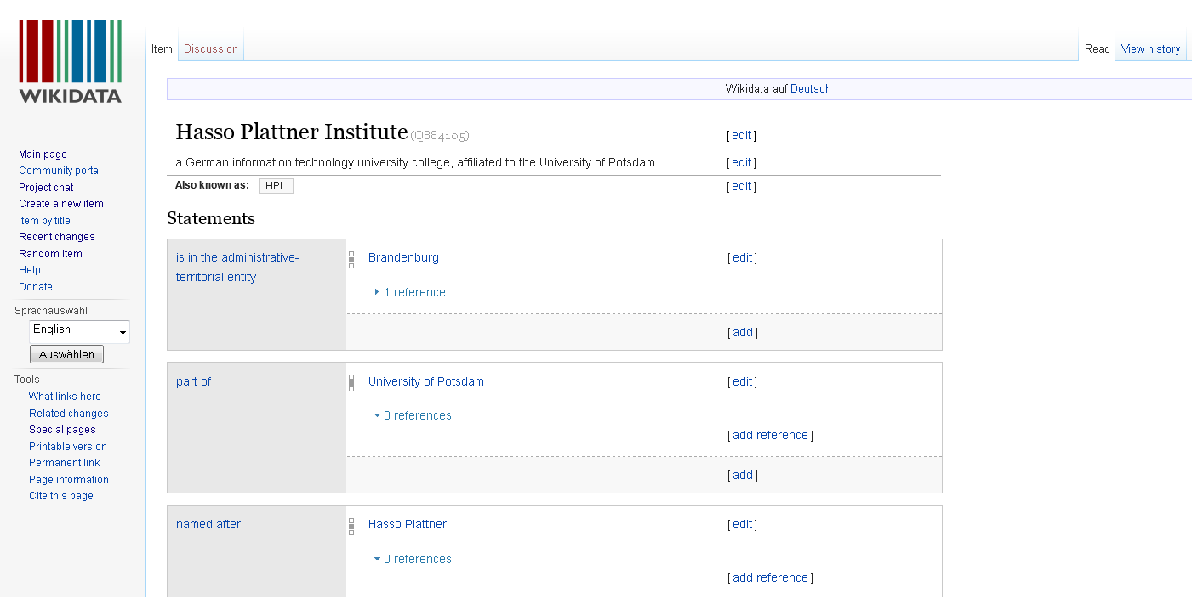
Wikidatas Content: Items

Slide 5
„Statement“ = Property + Value
Recorded and maintained by bots and Wikidata-Users: „Community“

Slide 6
Vision & Goals
Create a common data repository
Support other Wikimedia projects, e.g.. Wikipedia
Centralizing language links
Providing a central place for info box data for all Wikipedias
Creating and updating list articles based on data in Wikidata

Slide 7
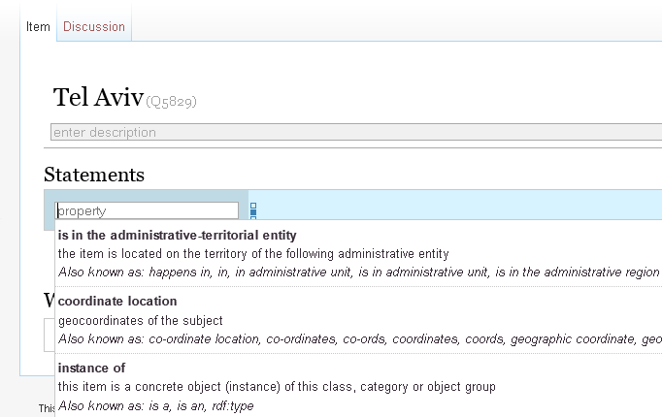
Achievement 1: Property Suggestions
Suggestions

Slide 8
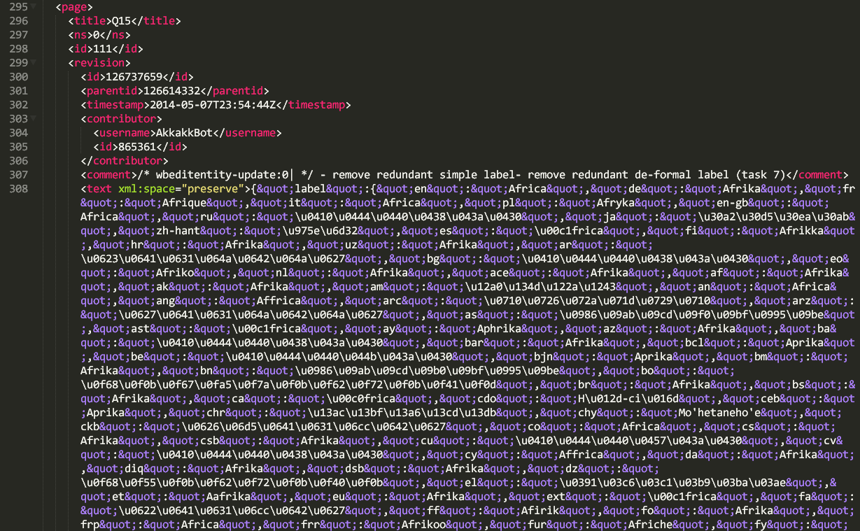
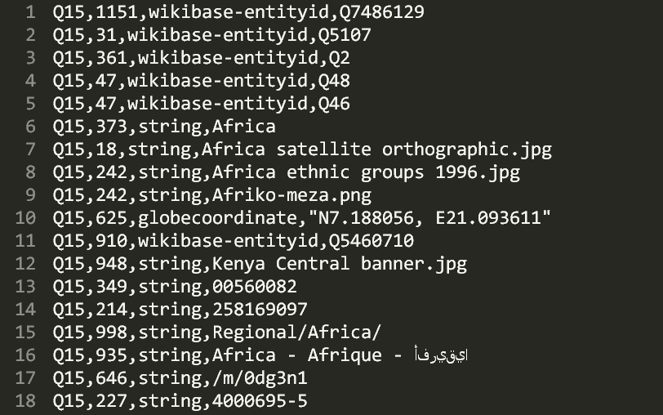
Dump parsing
Wikidata „Pages“ Dump: XML and Json
Reduction and conversion into CSV:
All statements: „subject – predicate – object “ = „Item – Property – Value“
Wikidata DUMP
CSV

Slide 9
Analysis
x
 | 1 | 2 | 3 | 4 | 5 | 6 | 7 | 8 | 9 | 10 | 11
1 | / | 0.2 | 0.4 | / | 0.1 | / | 0.2 | 0.3 | / |  | 0.6
2
3
4 | / | 0.4 | 0.5 | / | 0.7 | / | 0.1 | 0.4 | / |  | 0.5
5
6 | / | 0.8 | 0.9 | / | 0.1 | / | 0.1 | 0.4 | / |  | 0.1
7
8
9 | / | 0.5 | 0.1 | / | 0.2 | / | 0.9 | 0.7 | / |  | 0.1
10
11
y
Count property occurences.
Count property pair occurences.
Calculate:
P(„property x appears in an item whenever property y does“)
CSV

Slide 10
Analysis executed
at intervals
Requesting property suggestions
for a specific Item

Slide 11
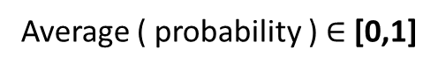
Ranking
Contemplated properties
 | 1 | 2 | 3 | 4 | 5 | 6 | 7 | 8 | 9 | 10 | 11
1 | / | 0.2 | 0.4 | / | 0.1 | / | 0.2 | 0.3 | / |  | 0.6
2
3
4 | / | 0.4 | 0.5 | / | 0.7 | / | 0.1 | 0.4 | / |  | 0.5
5
6 | / | 0.8 | 0.9 | / | 0.1 | / | 0.1 | 0.4 | / |  | 0.1
7
8
9 | / | 0.5 | 0.1 | / | 0.2 | / | 0.9 | 0.7 | / |  | 0.1
10
11
Properties already used in item
score
improvement
…Tf-idf?
Average ( probability ) $∈$ [0,1]

Slide 12
Improvement

Slide 13
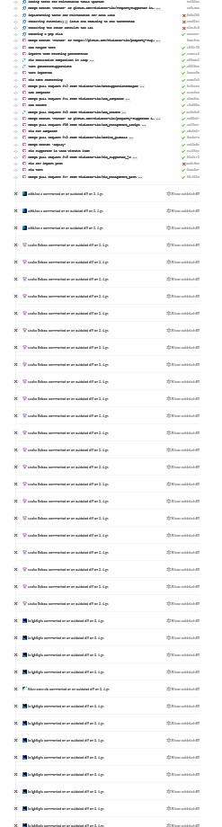
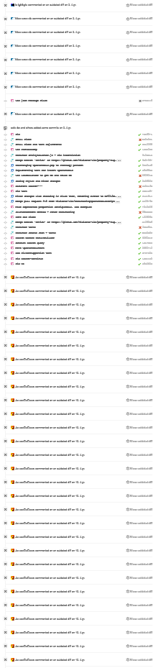
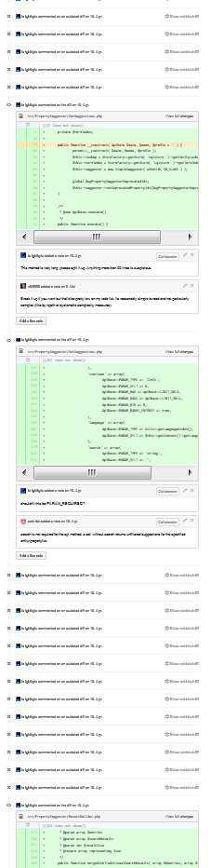
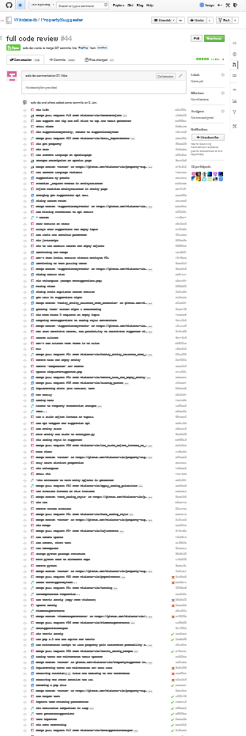
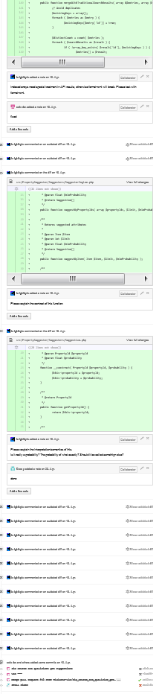
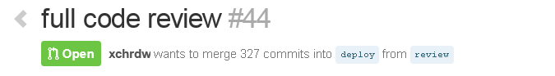
Refactoring
„we'll go ahead and have it
deployed with the next
Wikidata deployment on
June 10th.”

Slide 14
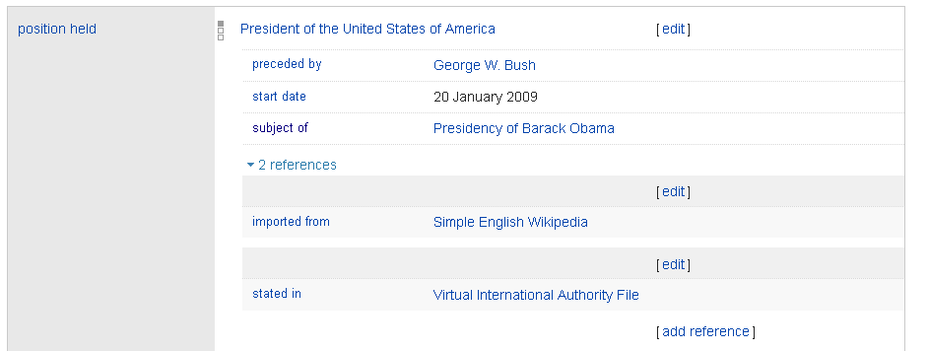
Sources & Qualifiers „Suggestions“

Slide 15
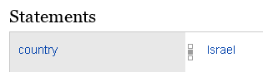
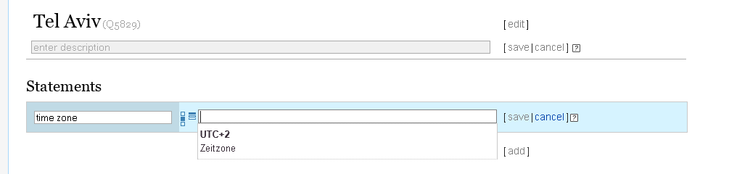
Achievement 2: Item - property dependent item search
WOW!
Magic ;-)

Slide 16
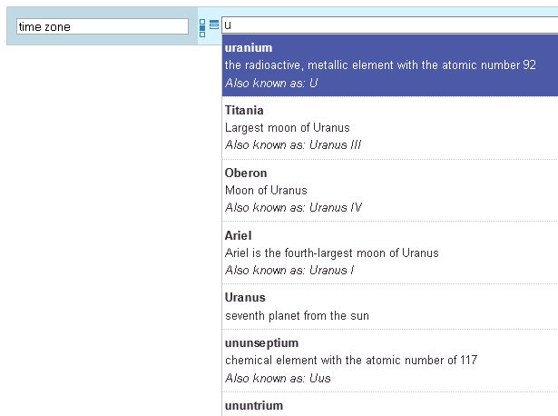
… instead of
Timezone = Uranium,
Titania, Oberon, Ariel,
Uranus, ununseptium,
ununtrium ?

Slide 17
Analysis
Consider Statements with value-type „item“ only.
step1: count statement occurrences
step2: select relevant statements ( #appearance > avg(appearance) x factor )
step3: count statement pair appearances (only if both statements are relevant)
step4: select relevant statement pairs → rules
step5: write to disk
CSV

Slide 18
Math

Slide 19
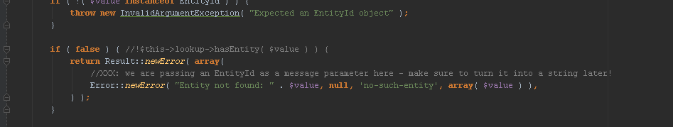
Local Test-Environment
Terms (of all Entities) required
Labels
Descriptions
For importing some specific items:

Slide 21
Achievement 3: Edit Item Page

Slide 22
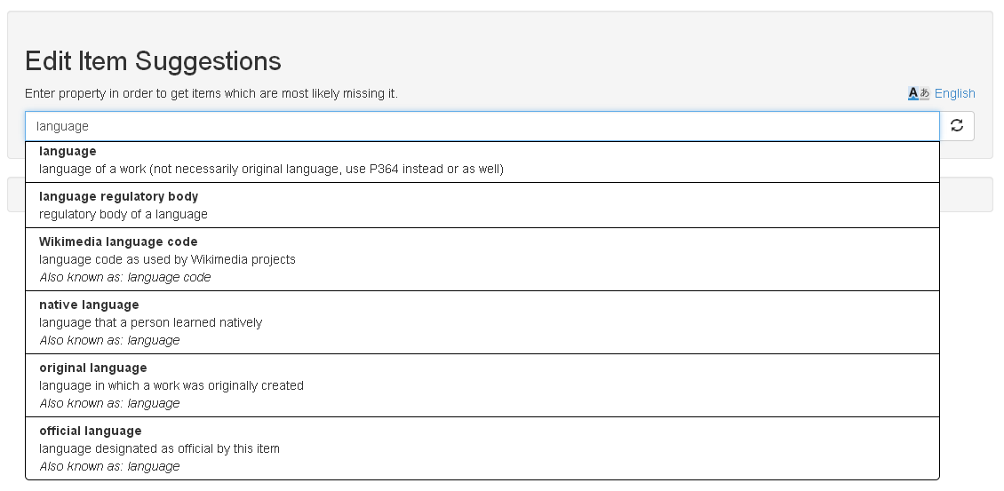
Notes:
Eigenschaft eingeben
Items, wo die Eigenschaft fehlt

Slide 23
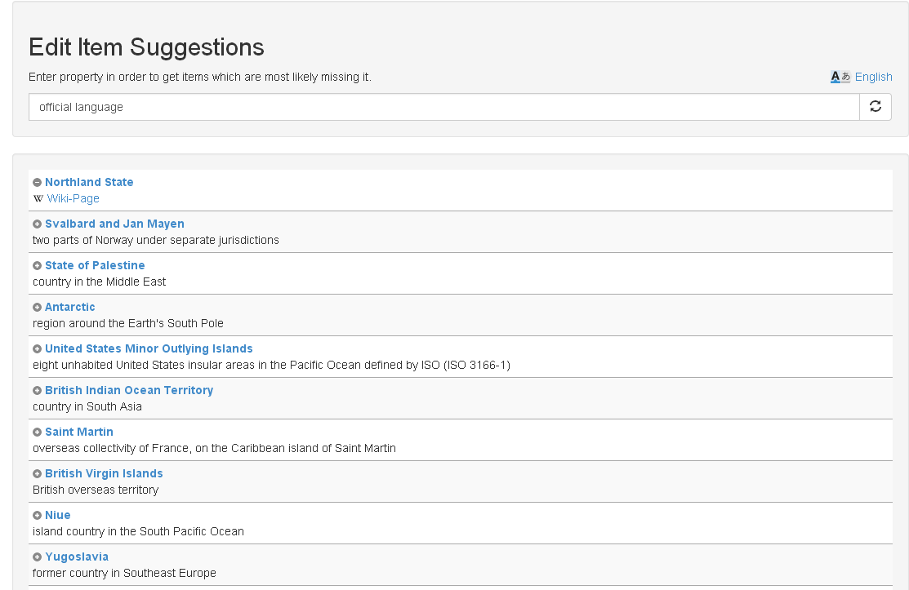
Notes:
Nach 10 min check ob es eingetragen wurde
Verschwindet von Website
Wikipedia Link
Direktes Eintragen
Gute Resonanz auf Wikidata mailingliste

Slide 24
Evaluation

Slide 25
Algorithm
Random Item
Suggester
Property 21
Property 33
Property 8
Property 4
getSuggestions
compare
result
Property 15
Property 4
Property 38
Property 24

Slide 26
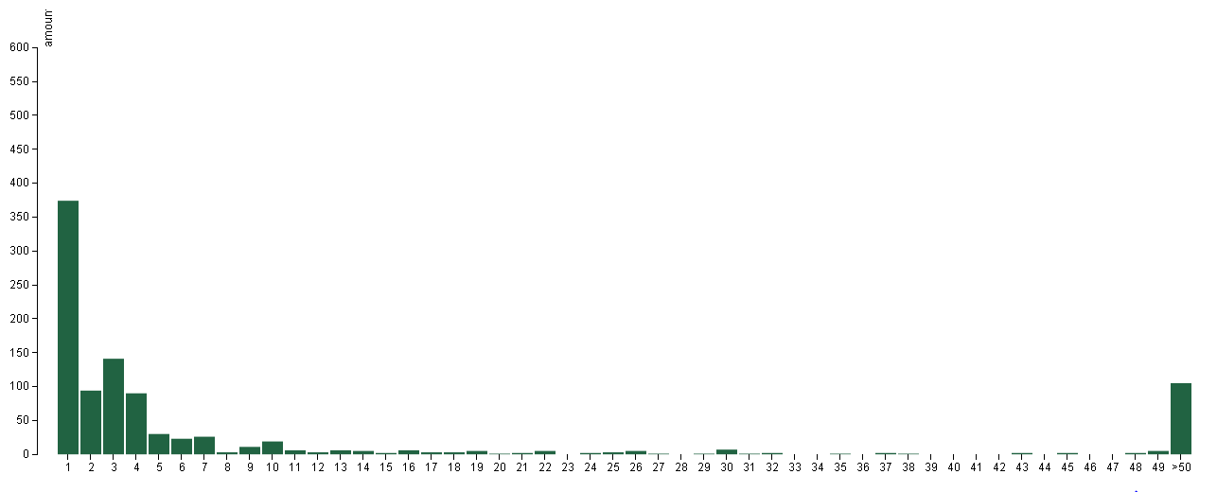
Results

Slide 27
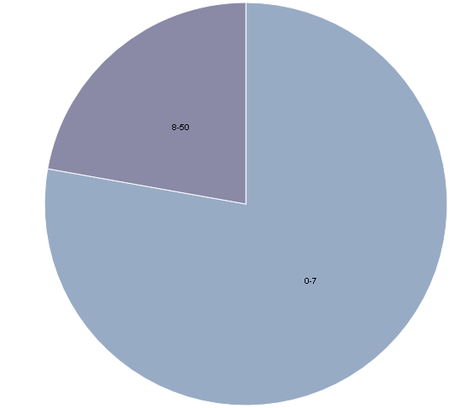
Distribution
8-50
1-7

Slide 28
First letter Algorithm
Random Item
Suggester
Property 21
Property 33
Property 8
Property 4
getSuggestions, search= firstLetter
compare
result
Property 15
Property 4
Property 38
Property 24
Notes:
Extended algorithm:
Provide first letter of missing property as search parameter for suggester
Use Case: User is starting to type

Slide 29
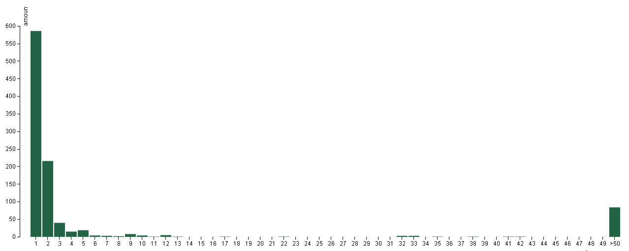
First letter evaluation

Slide 30
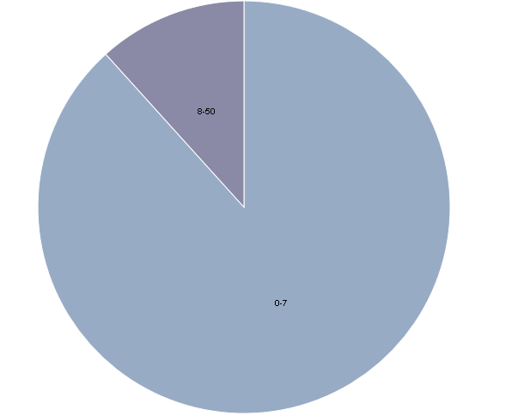
Distribution
8-50
1-7
Notes:
Blau: 1-7

Slide 31
data
Output:
CSV File
Amount per rank
Input: CSV file (preprocessed Wikidata csv dump) Total amount of items in dump: 6656575
Q15, 31, wikibase-entityid, Q5107 Q15, 47, wikibase-entityid, Q48 Q15, 361, wikibase-entityid, Q2 Q15, 47, wikibase-entityid, Q46 Q15, 373, string, Africa Q15, 18, string, Africa satellite.jpg Q15, 242, string, Africa ethnic groups 1996.jpg Q15, 242, string, Afriko-meza.png Q15, 625, globecoordinate, N7.186, E21.011 Q15, 910, wikibase-entityid, Q5460710
…
rank, amount
1, 374
2, 94
3, 141
4, 90
5, 30
6, 23
7, 26
8, 3
9, 11
10, 19
…

Slide 32


Implementation
Evaluator
Python
Modular structure to easily extend existing implementation
Visualization
d3.js
bar chart and pie chart
processes csv file

Slide 33
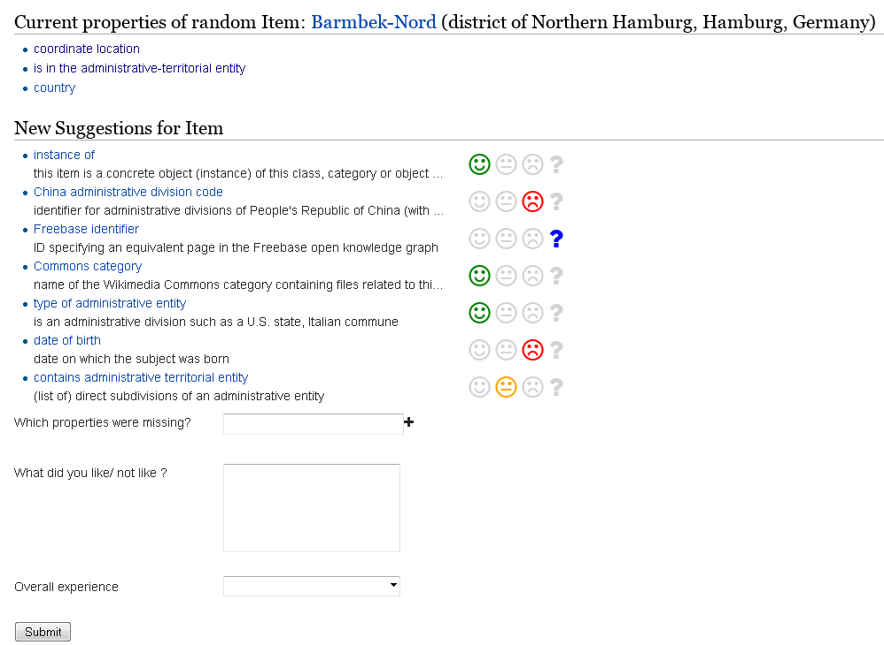
User Feedback Evaluation
User feedback to determine relevance (options)
User ranks suggestions to not relevant and relevant
Created a website for feedback
Crowdsourcing
Wikidata mailing list: 100 people

Slide 34
Hackathon Impressions

Slide 35
